Slide 1
Task 5 : Capture and Analyze Network Traffic Using Wireshark.
1. Objective : The objective of this task was to capture live network packets using Wireshark, filter them by protocol, and identify at least three different protocols present in the captured traffic.
2. Tools Used :
Wireshark (Windows 10)
3. Method :
Opened Wireshark and selected the active Wi-Fi interface.
Generated traffic by :
Browsing multiple websites.
Running google.com from Firefox address bar.
Using YouTube search.
Stopped capture after approximately 1 minute.
Applied protocol filters (dns, icmp, tcp, tls) to isolate traffic.
Saved capture as .pcap file.

Slide 2
4. Protocols Identified :
Protocol | Purpose | Example from Capture
DNS | Resolves domain names to IP addresses | Query for google.com → IP address reply
ICMP | Tests connectivity between devices | ping google.com echo request/reply
TCP/TLS | Handles secure website communication (HTTPS) | Connection to youtube.com over port 443

Slide 3
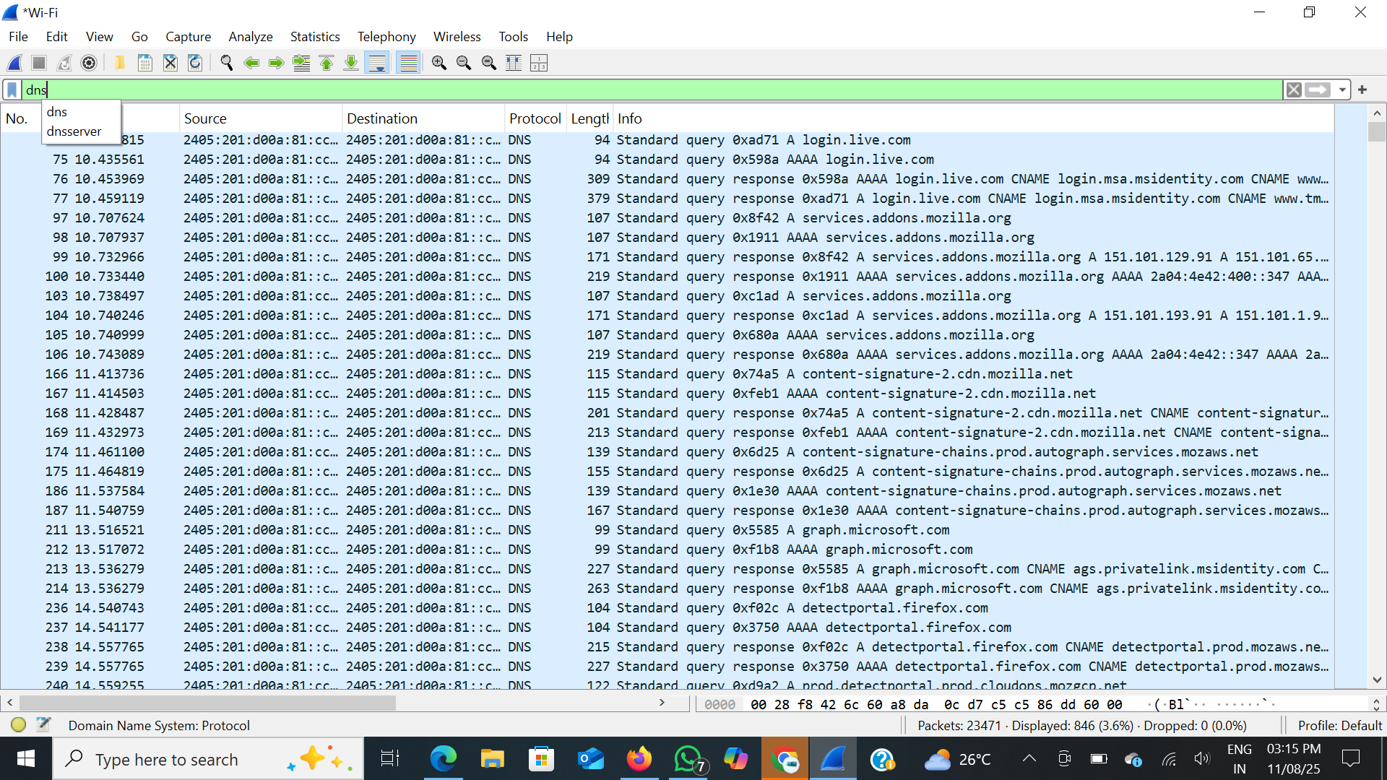
5. Screenshots
DNS Traffic :

Slide 4
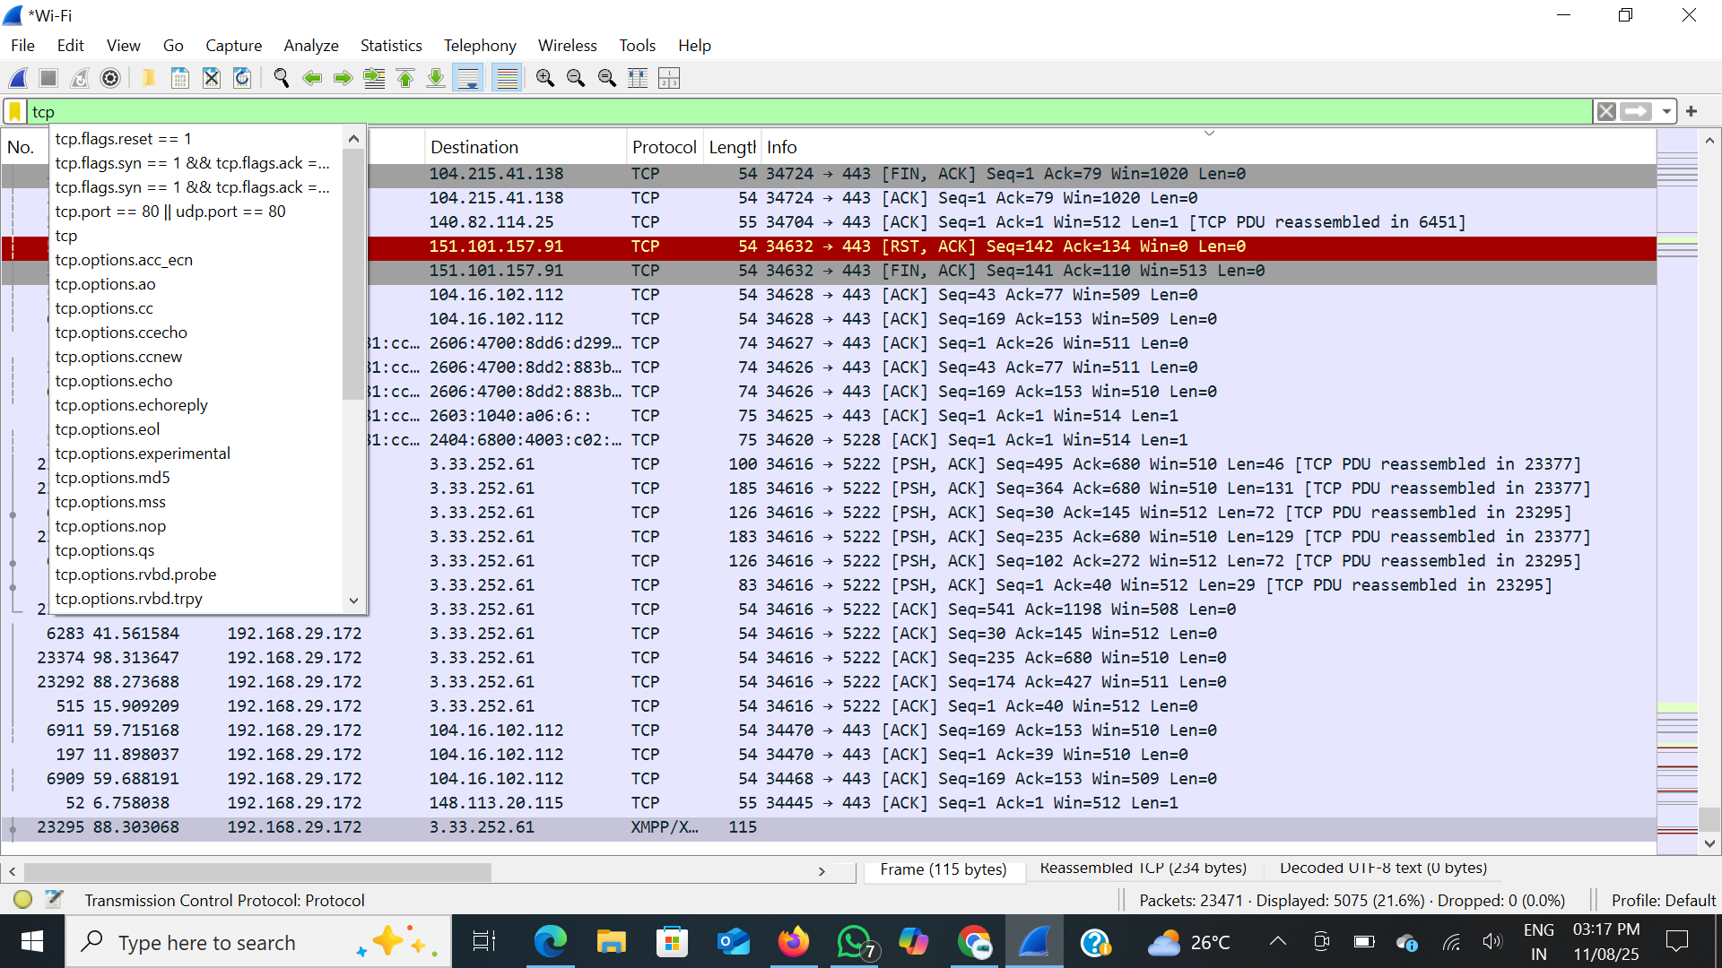
TCP Traffic :

Slide 5
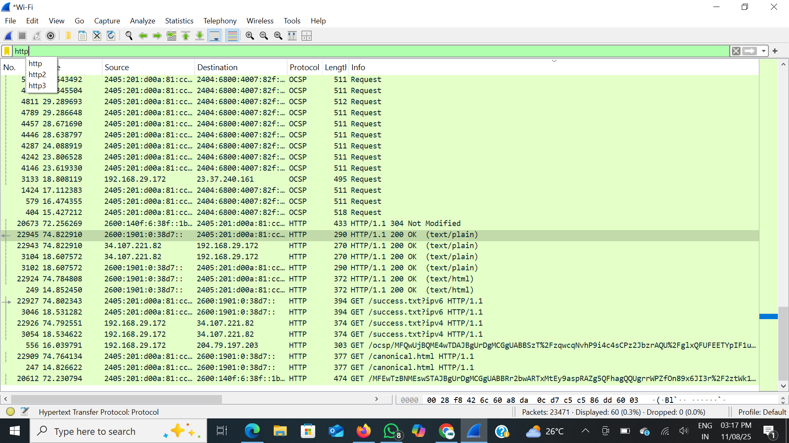
http Traffic :

Slide 6
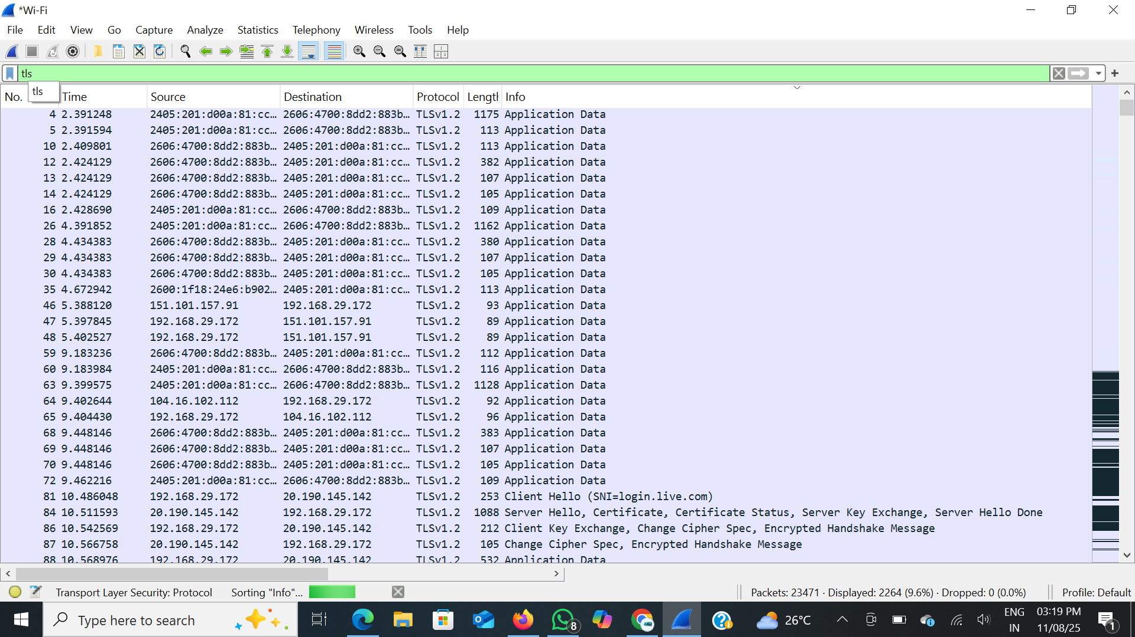
TCP/TLS Traffic :

Slide 7
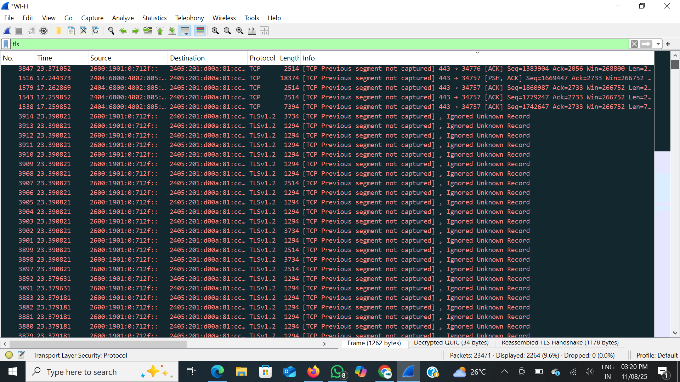

Slide 8
6. Observations :
DNS queries always occur before establishing website connections.
ICMP packets show round-trip time (RTT) between source and destination.
TLS encryption hides website content, showing only metadata like IP, port, and certificate exchange.
7. Conclusion : The analysis confirmed that common protocols like DNS, ICMP, and TCP/TLS are part of normal internet activity. Wireshark effectively captured and filtered traffic, providing clear insights into protocol functions and usage.

